Slide 1
ECommerce website

Slide 2
Agenda
Introduction
Entities and attributes
ER diagrams
Tables
Queries
Views

Slide 3
INTRODUCTION: The aim of this project is to design and implement a comprehensive and scalable e-commerce database system that efficiently manages product information, customer details, transaction data, inventory management, and sales tracking. The primary objective of maintaining a database for an eCommerce website is to streamline the management of product inventory, customer information, and transaction details. This makes it easier for both the customers and the business to track orders, update product listings, and handle customer service inquiries.

Slide 4
ENTITIES AND ATTRIBUTES:
ENTITIES | ATTRIBUTES
Products | ProductID ProductName Price
Customers | CustomerID Name Email Address
Orders | OrderID CustomerID ProductID (FK) Quantity OrderDate
Inventory | ProductID (FK) QuantityInStock
Sales | SaleID OrderID (FK) ProductID (FK) CustomerID (FK)

Slide 5
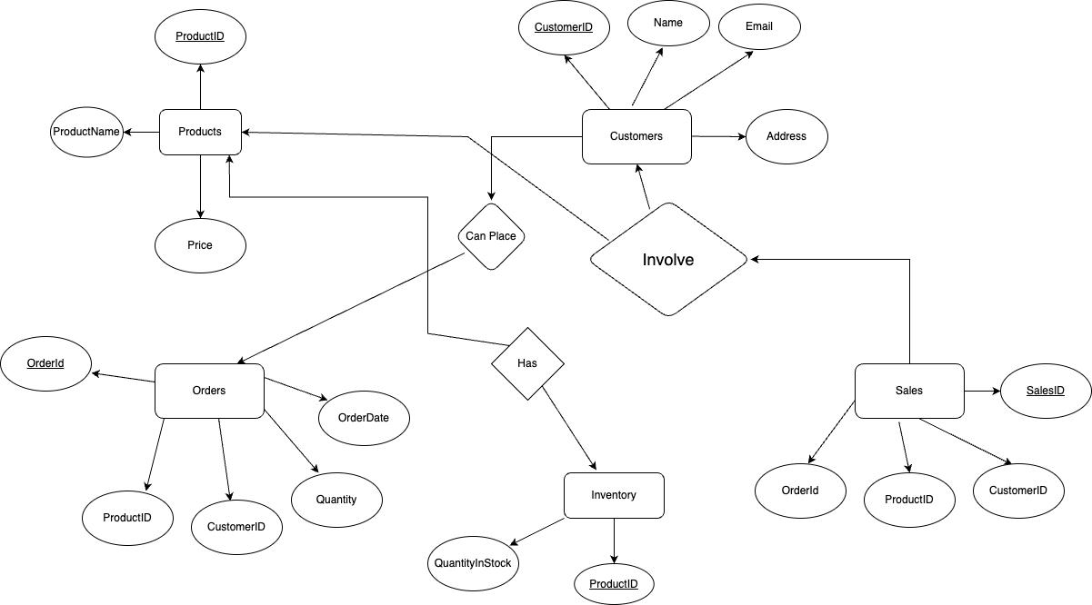
ER Diagram:

Slide 6
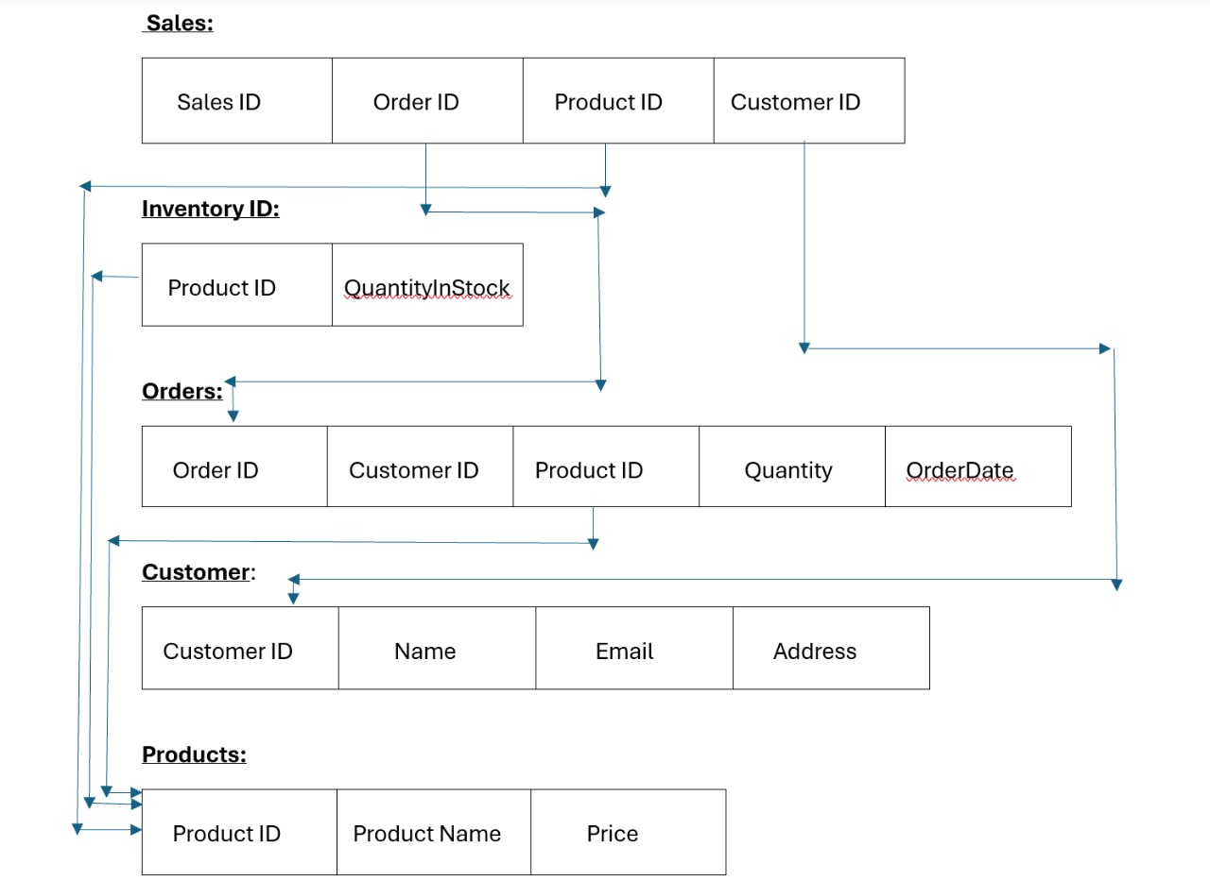
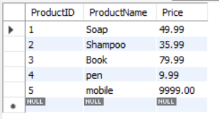
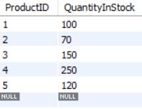
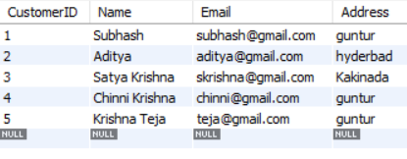
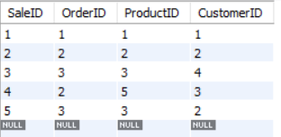
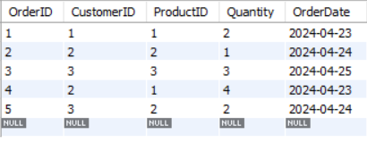
Tables:
Products
Inventory
Customers
Sales
Orders

Slide 7




Queries:
SELECT * FROM Products;
SELECT * FROM Customers WHERE Email = 'chinni@gmail.com';
SELECT * FROM Orders WHERE CustomerID = 2;
SELECT * FROM Sales WHERE OrderID = 3;
SELECT * FROM Inventory WHERE ProductID = 1;

Slide 8
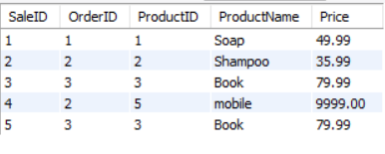
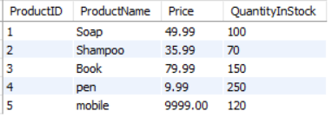
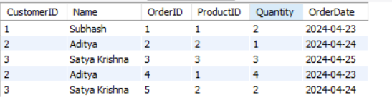
Views:
CREATE VIEW SalesWithProductDetails AS
SELECT S.SaleID, S.OrderID, P.ProductID, P.ProductName, P.Price
FROM Sales S
JOIN Products P ON S.ProductID = P.ProductID;
SELECT * FROM SalesWithProductDetails;
CREATE VIEW ProductsWithInventory AS
SELECT P.ProductID, P.ProductName, P.Price, I.QuantityInStock
FROM Products P
JOIN Inventory I ON P.ProductID = I.ProductID;
CREATE VIEW CustomersAndOrders AS
SELECT C.CustomerID, C.Name, O.OrderID, O.ProductID, O.Quantity, O.OrderDate
FROM Customers C
JOIN Orders O ON C.CustomerID = O.CustomerID;

Slide 9
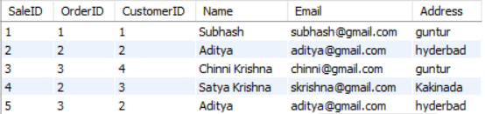
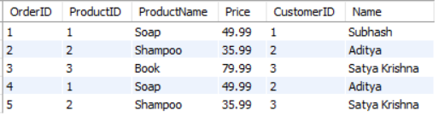
CREATE VIEW SalesWithCustomerDetails AS
SELECT S.SaleID, S.OrderID, C.CustomerID, C.Name, C.Email, C.Address
FROM Sales S
JOIN Customers C ON S.CustomerID = C.CustomerID;
CREATE VIEW OrdersWithDetails AS
SELECT O.OrderID, P.ProductID, P.ProductName, P.Price, C.CustomerID, C.Name
FROM Orders O
JOIN Products P ON O.ProductID = P.ProductID
JOIN Customers C ON O.CustomerID = C.CustomerID;

Slide 10
Thank You

